Slide 1
Get Paid Today (not Tomorrow)
Good Business Pays

Slide 2
Our Mission
We are a social movement that will bring the issue of unfair slow and late payments for SMEs to the top of the national agenda …
… encouraging supporters from right across the business community and the whole country to campaign for change.

Slide 3
We help support small business by …
Providing free insight & knowledge to help them avoid or cope with late payment issues
Influencing a Faster Payment culture and practice across businesses
Influencing a reducing the Late & Slow Payment culture that has existed for over 50 years in UK businesses
Campaigning for Change across all political parties

Slide 4
How Good Business Pays works to drive change
Engagement
Insight
Data
Data Analysis
GBP Portal (Live Data Feed)
18 Sector Specific Reports
Best and worst payer reports/lists
Multi-Year reports by individual company or sector
Public Sector Payment Performance (400 Local Authorities; NHS Trusts; Police Forces)
Individual Company performance profiles with sic data
Thought Leadership
Understanding Payment Culture
Who Cares Report?
Payment Culture Reports by company over time
Late & Slow Watchlist
Campaigns (eg “Wait Off”)
Functional Events (eg AP Association/CIPS)
Industry events (eg BTA Conference)
Fast Payer Awards and support to winners
GBP TV and Podcast
Collaboration with over 20 business organisations
Media coverage
Awareness Understanding Change

Slide 5
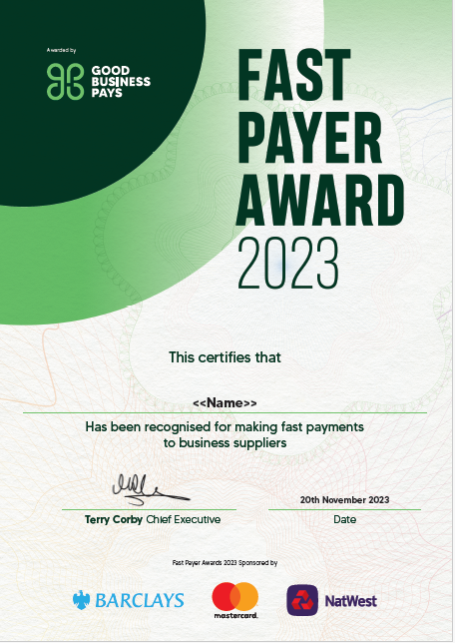
Fast Payer Awards become a more important ESG award each year
Nearly 300 winners (up around 25% over past year)
Our sponsors put their name to the awards for the first time
Ministerial and FSB support
Value of awards recognised by the winners

Slide 6
We recognised the worst payers …… and they improved payment terms!

Slide 7
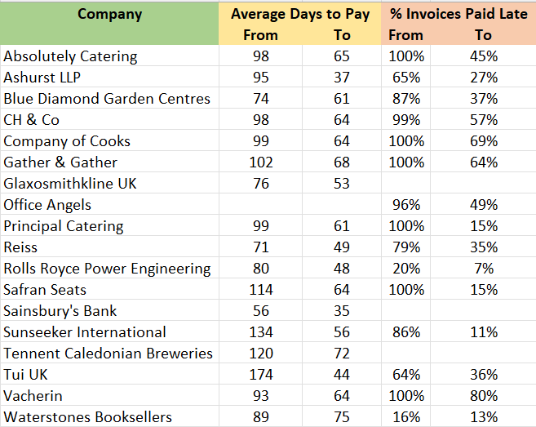
In 2023 we directly influenced a reduction in slow and late payment at more than 50 large companies
…. helping thousands of their small and medium sized suppliers

Slide 8
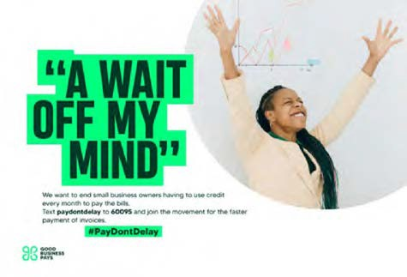
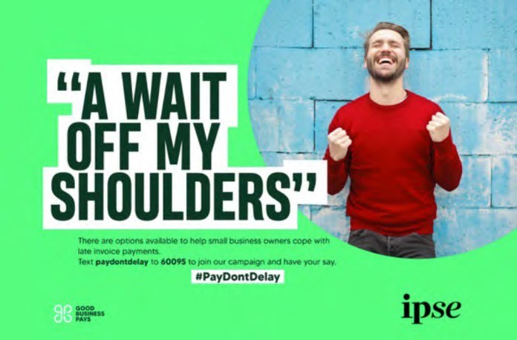
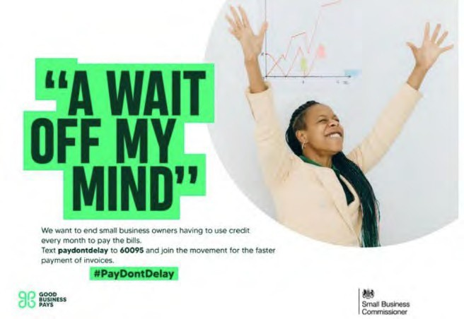
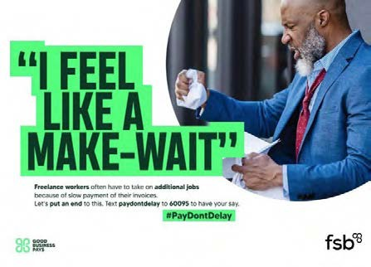
Our ‘Wait Off’ campaign communicates how late payments
affects business owners

Slide 9
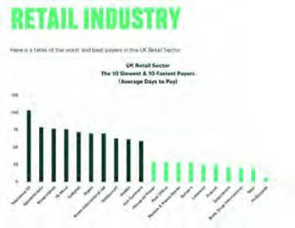
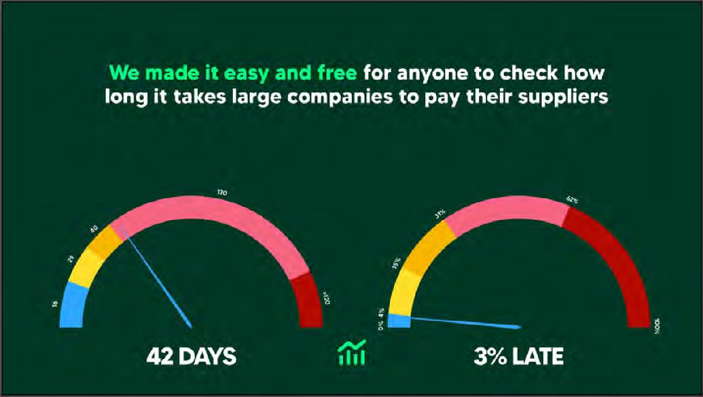
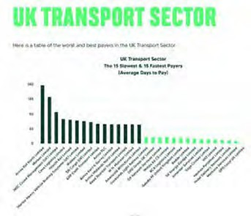
We provide free and easy to understand access to financial data and insights

Slide 10
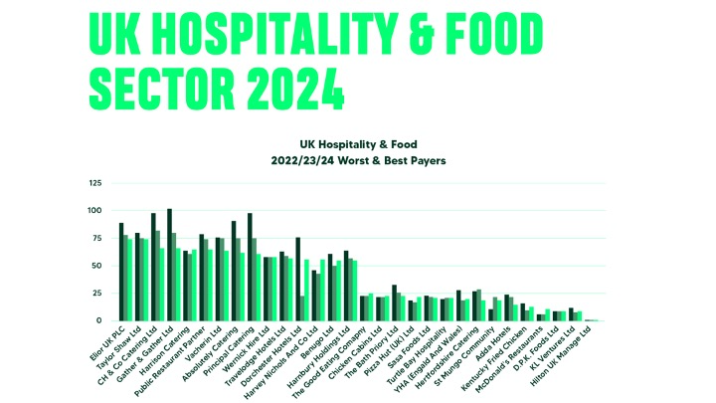
Sector charts show the best and worst 15 payers and their performance over the past three years

Slide 11
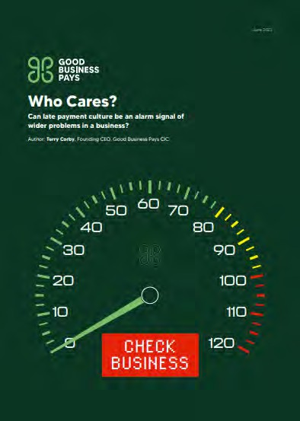
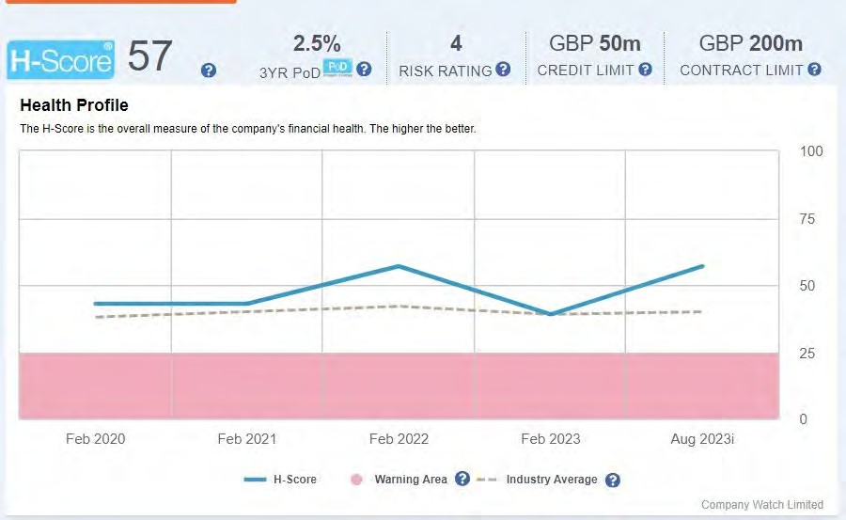
Does slow or late payment mean your client is risky to serve?

Slide 12
Evans Retail - Average Invoice Payment Times (Days)
Arcadia Administration
Nov 2020

Slide 13
Miss Selfridge Retail - Average Invoice Payment Times (Days)
Miss Selfridge
Arcadia Administration
Nov 2020

Slide 14
Joules Ltd - Average Invoice Payment Times (Days)
Administration
Jan 2022
Joules

Slide 15
McColl’s - Average Invoice Payment Times (Days)
McColl’s stopped reporting in June 2019 – entered Administration May 2022

Slide 16
Flybe Aviation - Average Invoice Payment Times (Days)
Flybe stopped reporting 2019 – entered Administration
Jan 2023

Slide 17
Midas Construction Ltd 2018 – 2021 Average Invoice Payment Times (Days)
Midas entered
Administration Feb 2022
Midas Construction

Slide 18
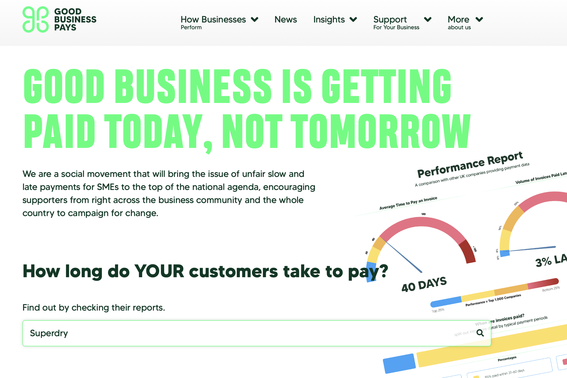
Company Search – Superdry example

Slide 19
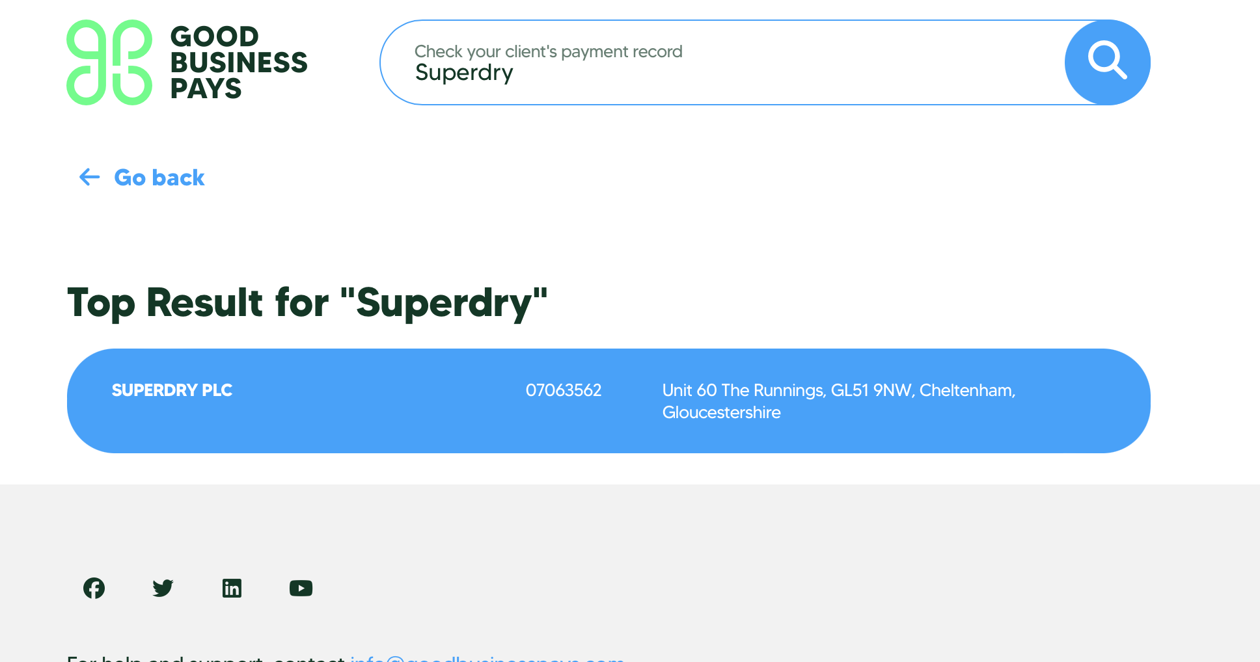
Superdry Payment Performance Profile

Slide 20
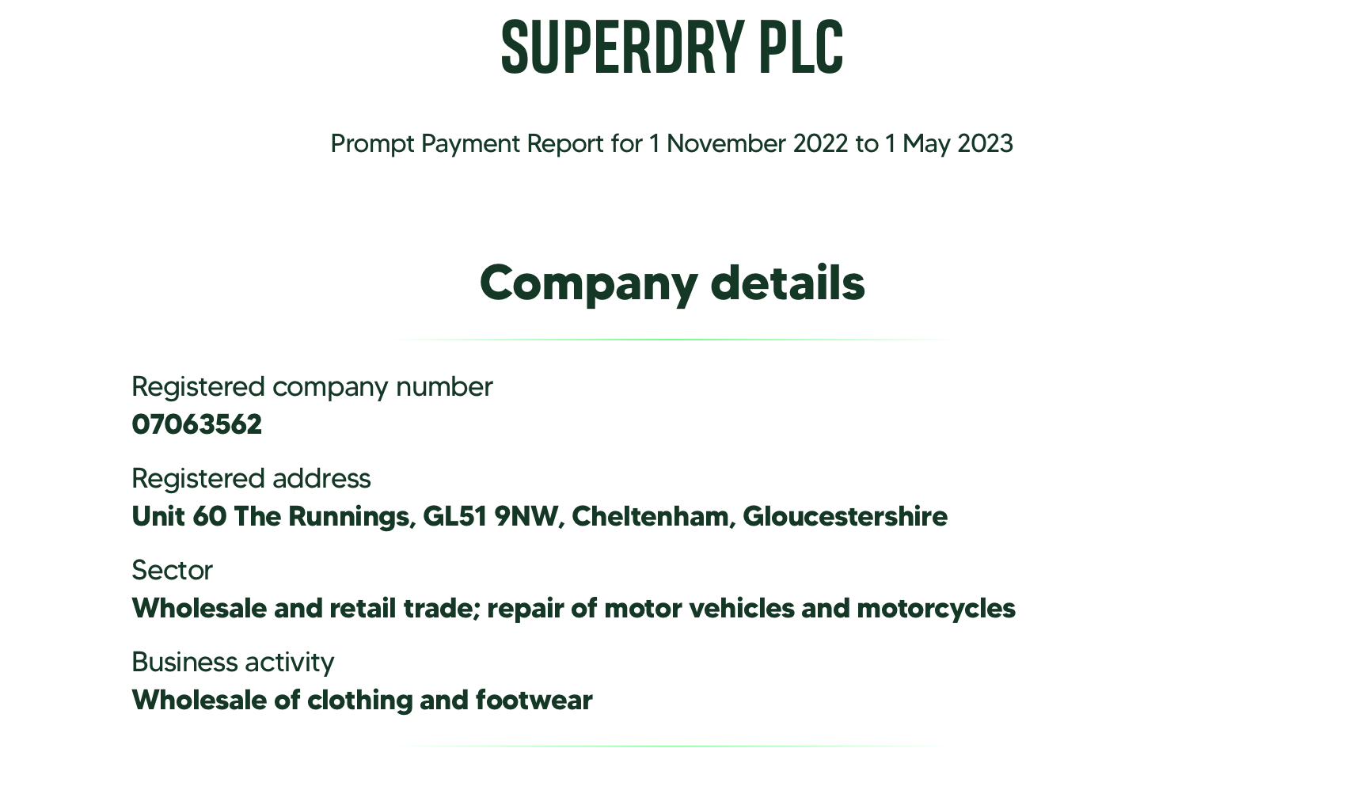
Superdry Company Details

Slide 21
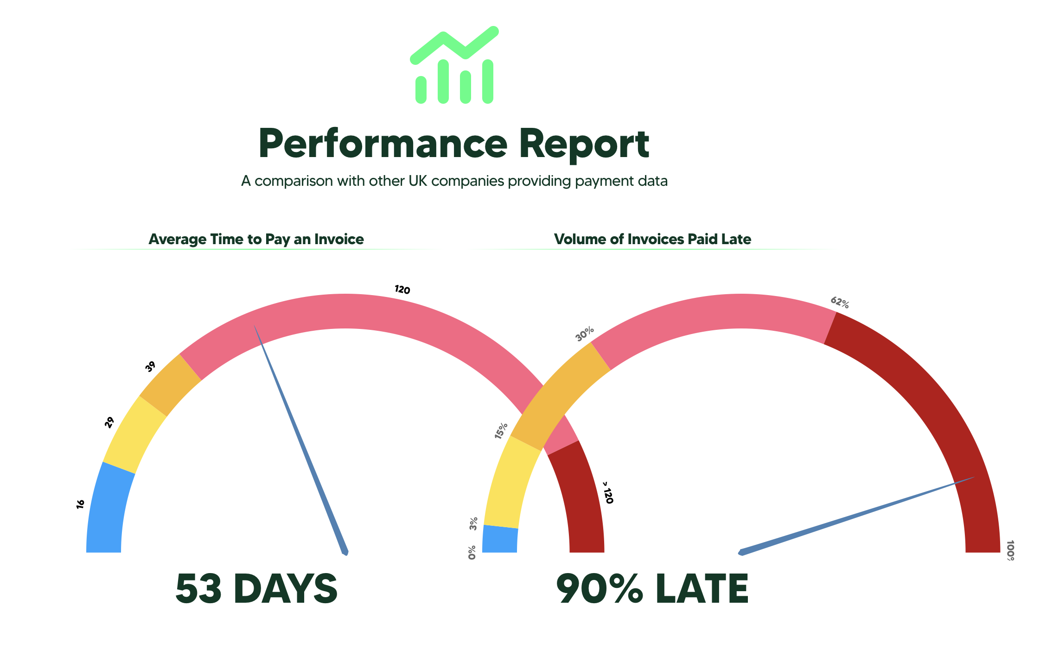
Superdry Payment Performance

Slide 22
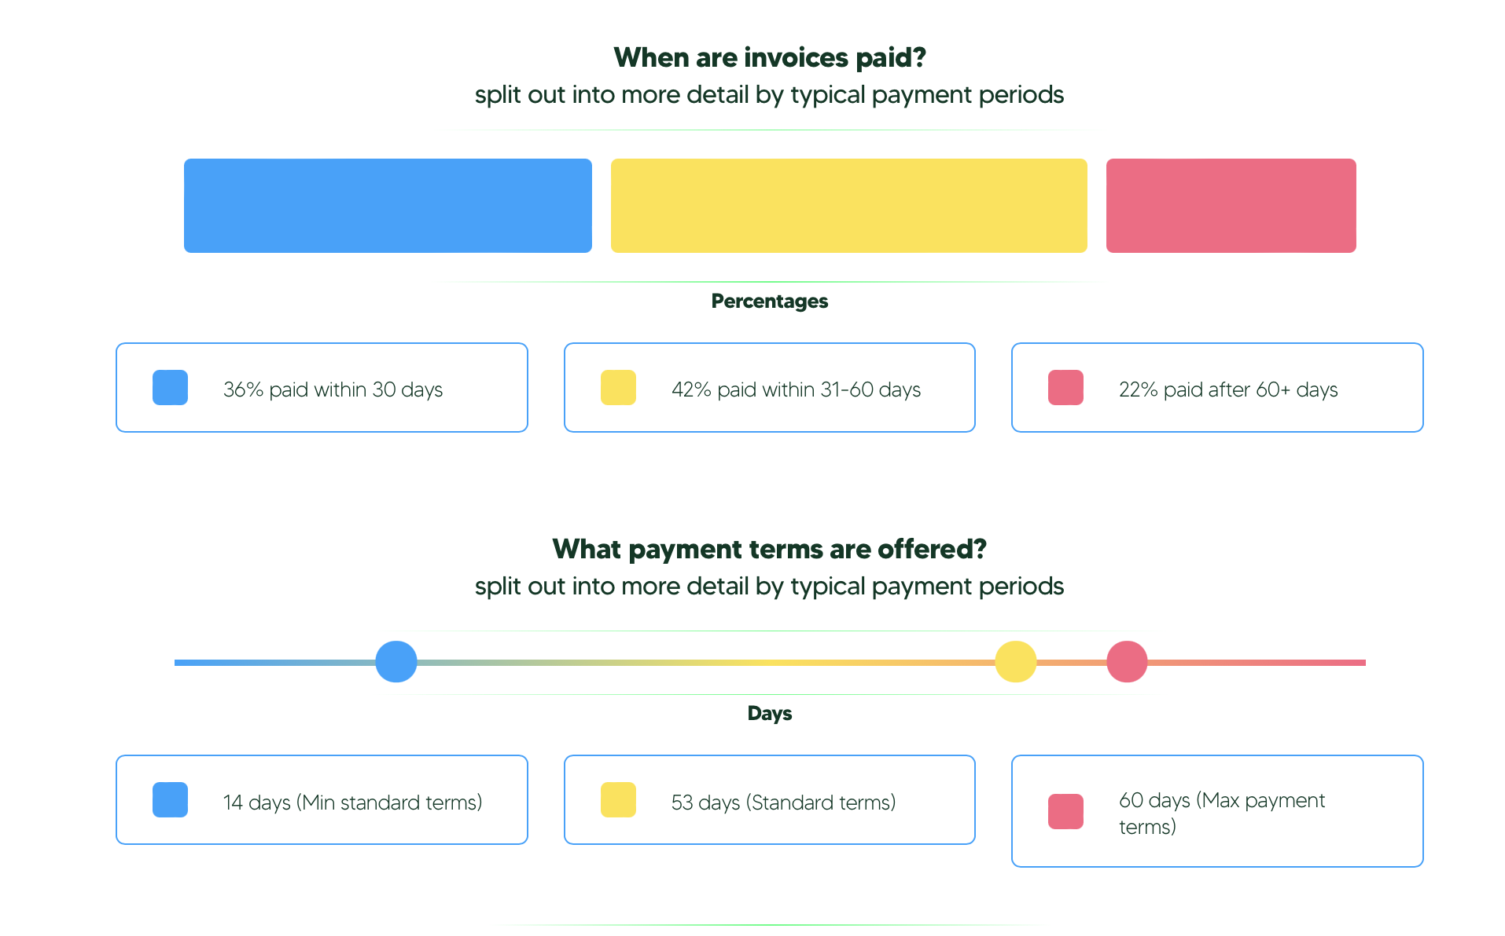
Superdry Payment Terms

Slide 23
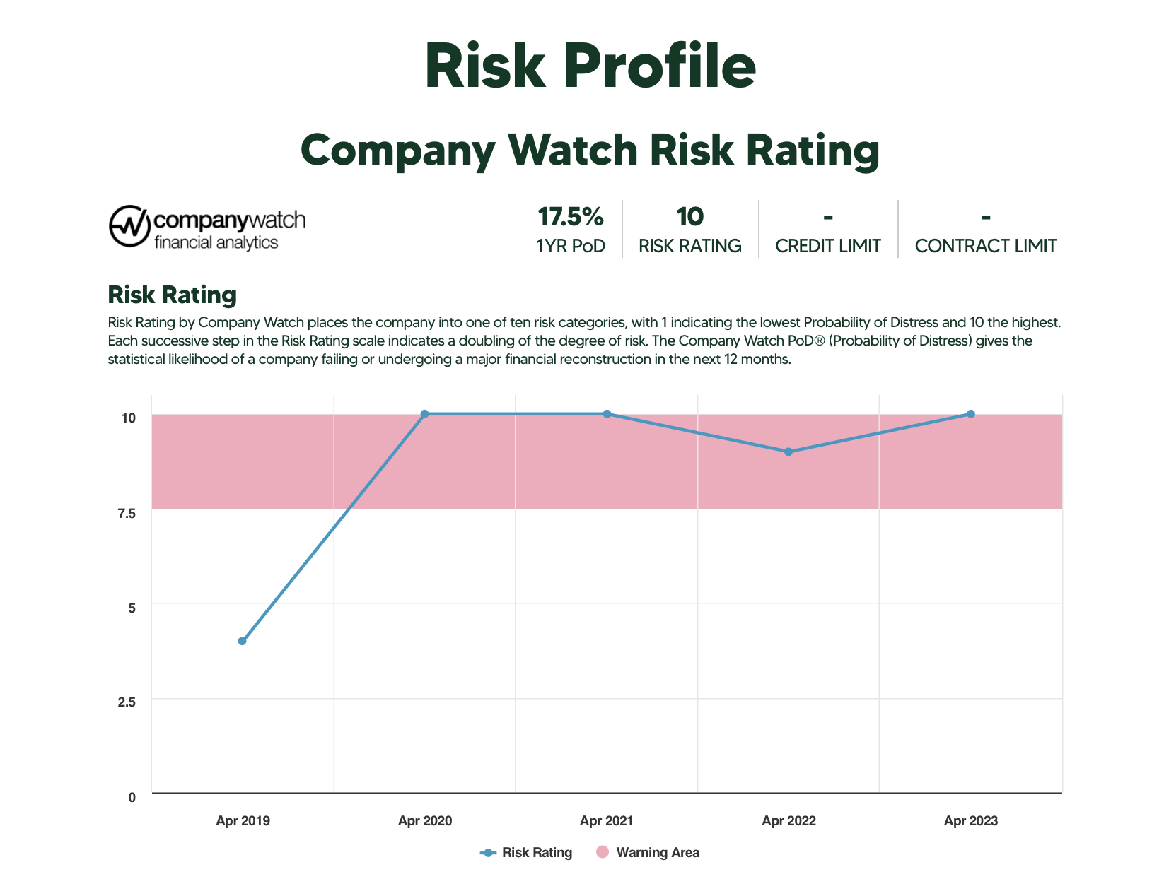
Superdry Risk Profile

Slide 24
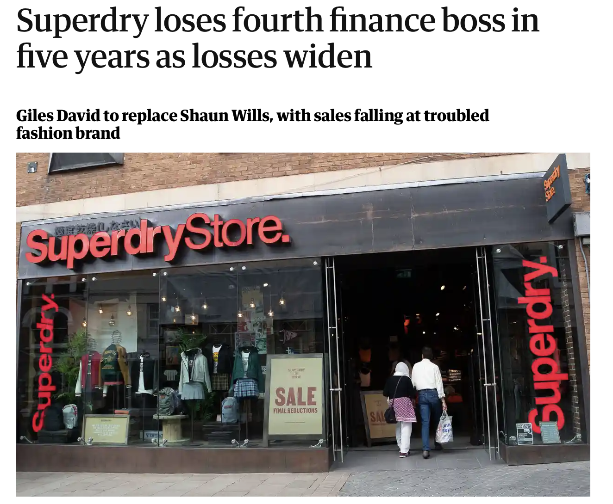
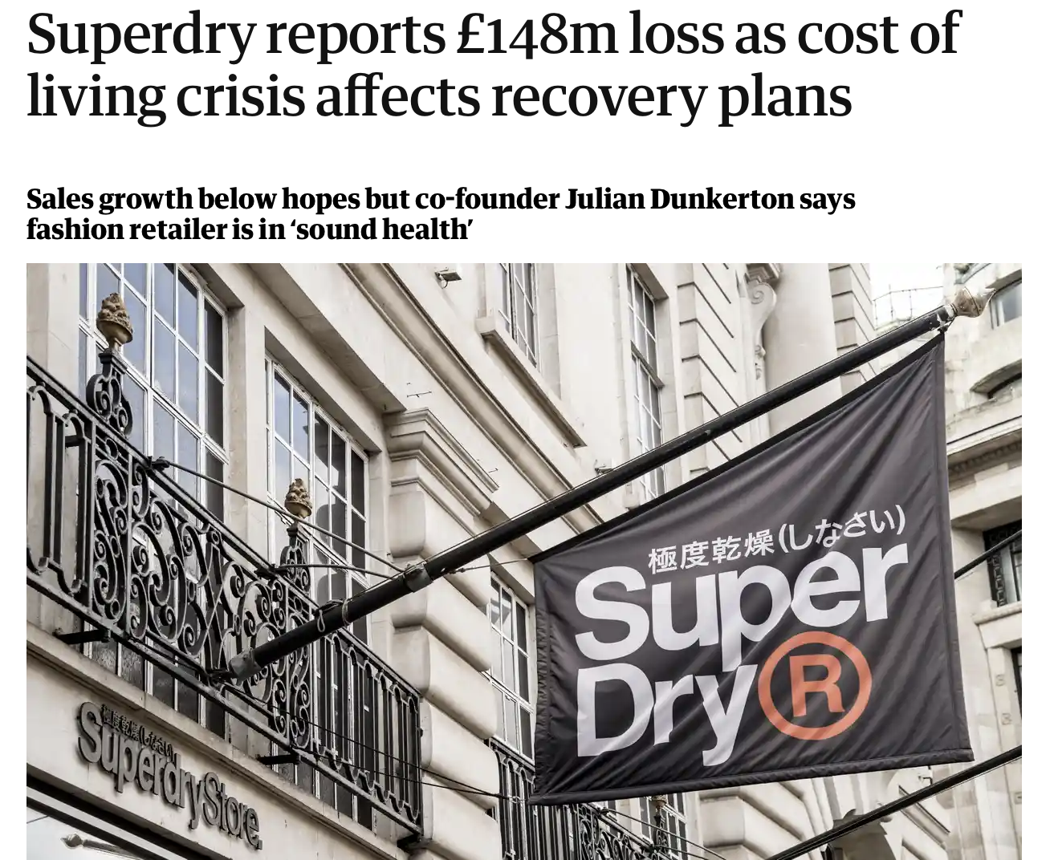
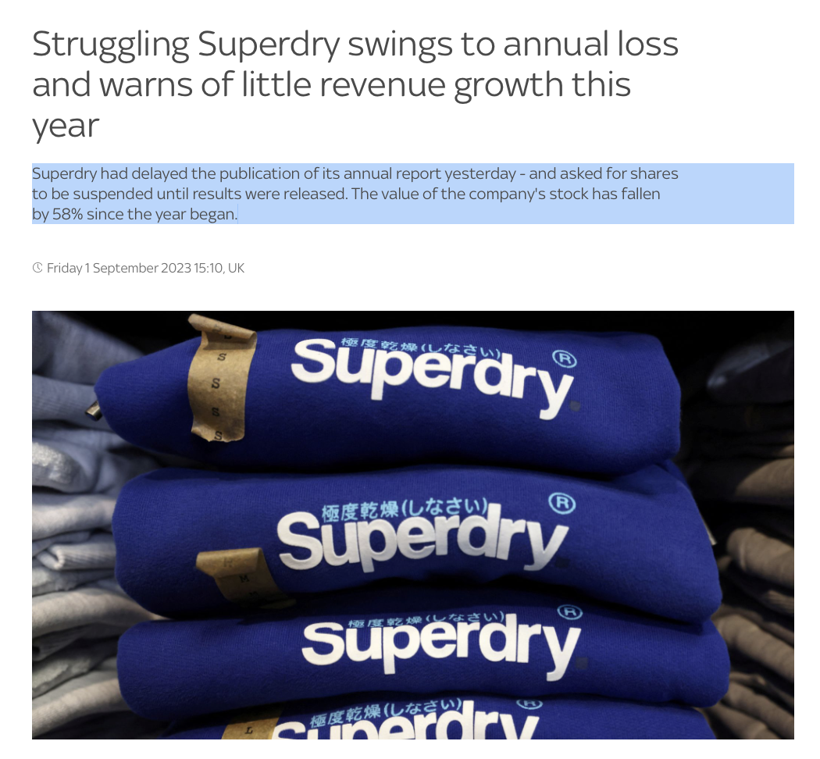
Superdry News

Slide 25
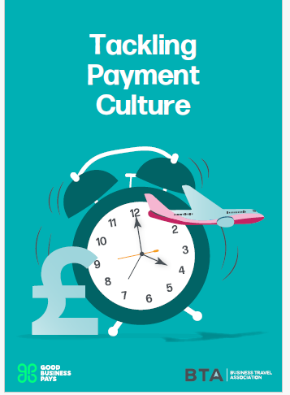
Our recommendations along with those from the BTA are all here

Slide 26
Thank you for joining! www.goodbusinesspays.com
Good Business Pays

