Slide 1
Are your invoices being paid on time?
Terry Corby, Founder & CEO Good Business Pays

Slide 2
OurMission
We are a social movement that will bring the issue of unfair slow and late payments for SMEs to the top of the national agenda …
… encouraging supporters from right across the business community and the whole country to campaign for change.

Slide 3
Our brilliant sponsors!

Slide 5
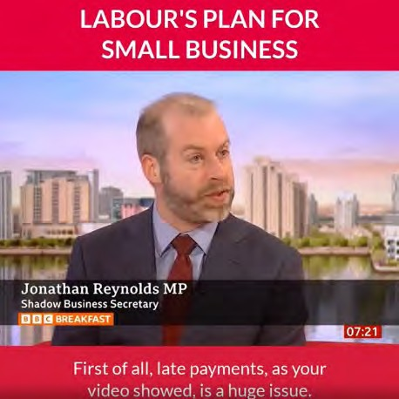
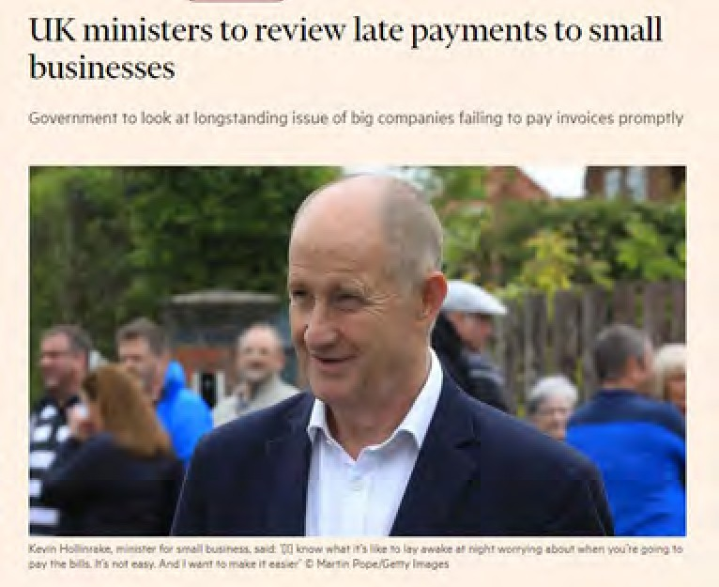
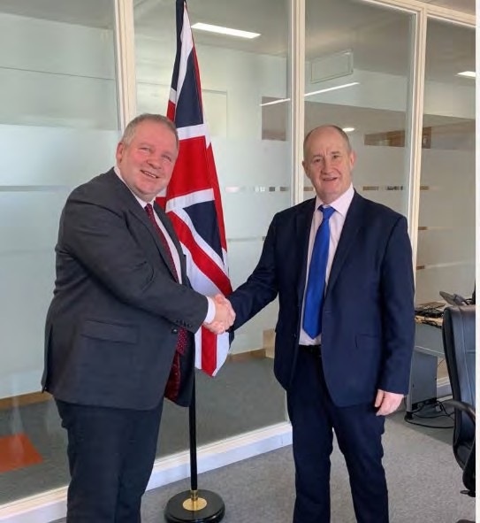
Cross-Party support for bringing an end to late payments to SMEs

Slide 6
Understanding Payment Culture
What is it?
The Good, the Bad and the Ugly
What can you do about it?

Slide 7
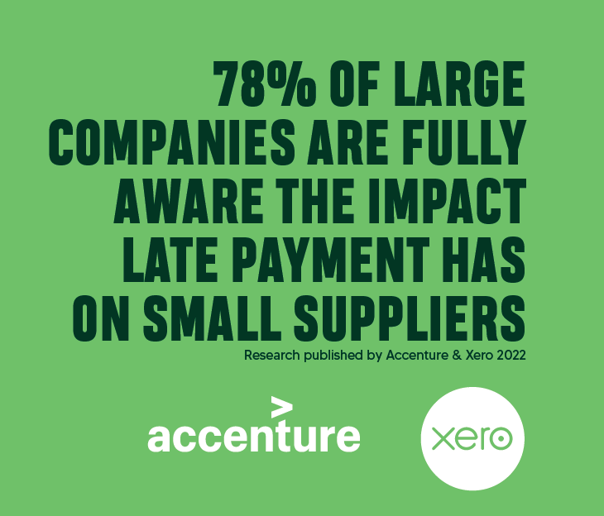
Payment Culture is a choice

Slide 8
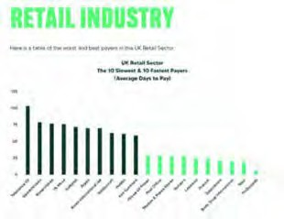
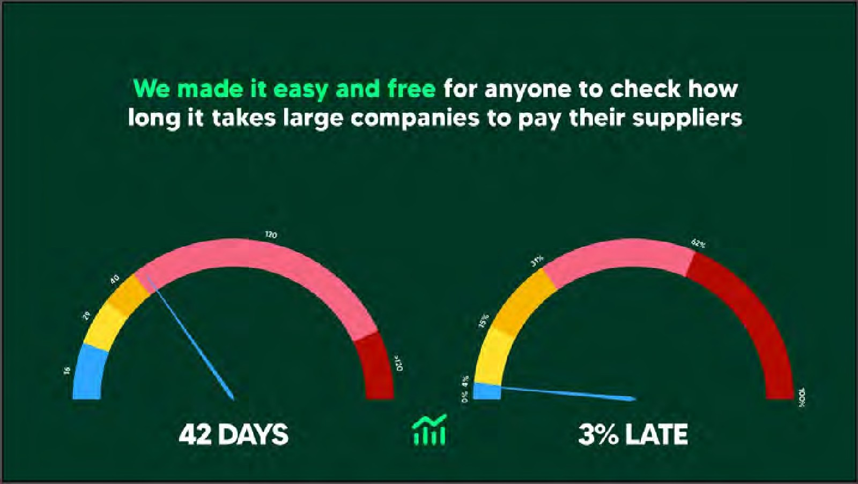
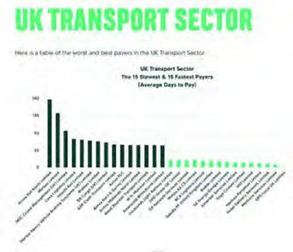
We provide free and easy to help you understand how long big companies take to pay

Slide 9
The Good!
Five Insights from the Fast-Paying Companies
300 large companies are fast payers (without shouting about it!)
Fast payment is a behaviour – set by leadership and followed by management
Payment culture is a sign of company culture
Fast payment culture is set by experienced leaders
Fast payers and their suppliers work in partnership

Slide 10
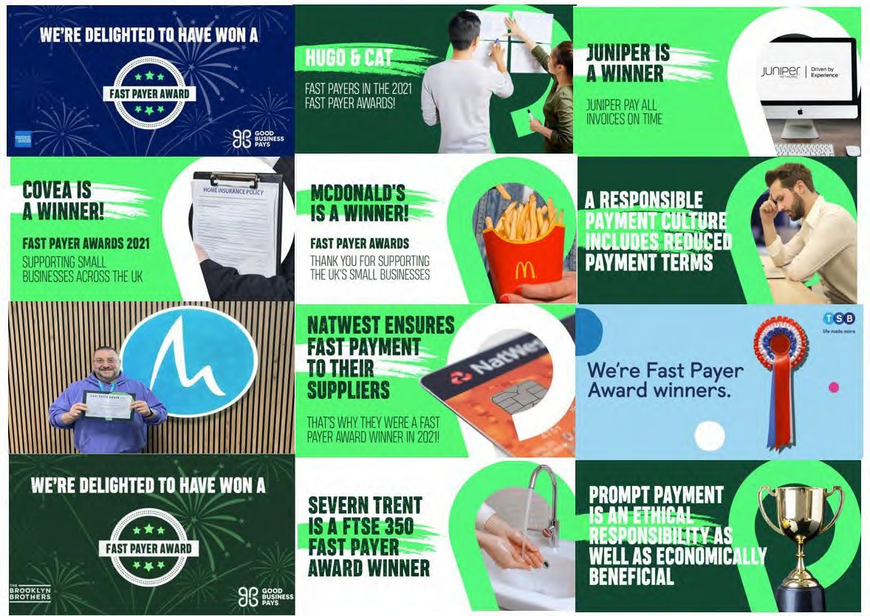
Customers of choice! Work with these to be paid fast!

Slide 11
Fast Payment stories on Good Business Pays TV
YouTube Channel @GBP_TV 478 views,
26.2 hours watch time
72 podcast episodes downloaded
37% of podcasts are listened to on Spotify

Slide 12
Understanding Fast Payment Culture – Strong Partnerships
Annual procurement budget of more than £1.1bn
1,700 regional, national, and international suppliers
Develop relationships with their key partners and suppliers, based on common values
More than 70% of the company’s annual supply chain spend is on the top 50 suppliers
That’s £110m on 1650 suppliers (£60k each)
UU aim to pay suppliers as soon as they can, with an average of around 13 days
At the height of the pandemic this was as quick as seven days in some instances
“Having listened carefully to suppliers, we recognise how important it is to pay promptly to ensure a constant and consistent cash flow for them,” he says. “We aim to pay our suppliers as soon as we can, with an average of around 13 days. At the height of the pandemic this was as quick as seven days in some instances.”

Slide 13
Understanding Fast Payment Culture – The In-Betweeners
Severn Valves manufacture and support high quality valves for the energy industries
Serving very large customers means it often has the challenge of being in the middle of very different payment terms
Some larger customers pay fast and others might take ninety or more days to pay
Most of their suppliers are on 30-day payment terms and won’t accept anything beyond that
The squeeze comes if Severn have longer, 60-day plus payment terms from their customers
“Everything is about developing the right partnerships, whether it is operators or suppliers. We sit at the centre of the supply chain in the energy sector and just like a house buying chain, if there is a problemin the chain the whole chain breaks down. If we don’t manage our partnerships effectively and the cashflow around that, the whole supply chain breaks down.”

Slide 14
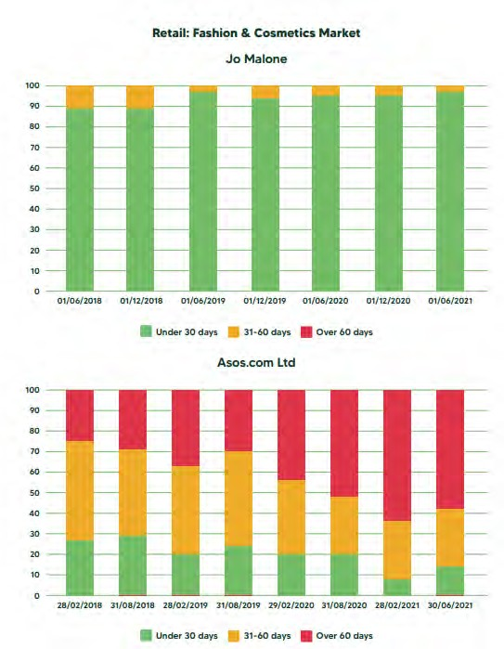
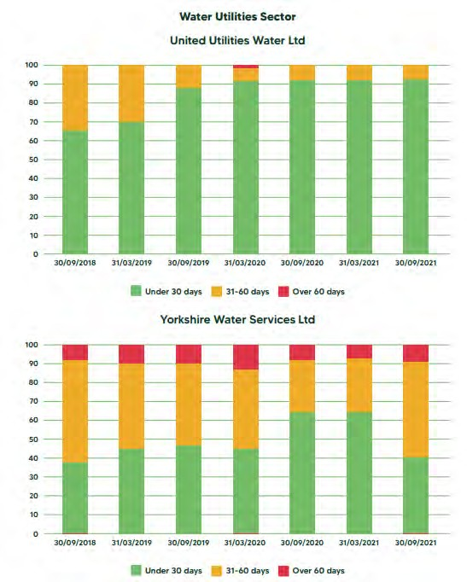
We have visualised Company Payment Culture

Slide 15
The Bad ……

Slide 16
Late Payment by Region (Xero Data)
10
8
6
4
2
0
East of England 48% worse
London 26% worse
North West 28% worse
Scotland 45% worse
West Midlands 33% worse
01/2022
01/2023

Slide 17
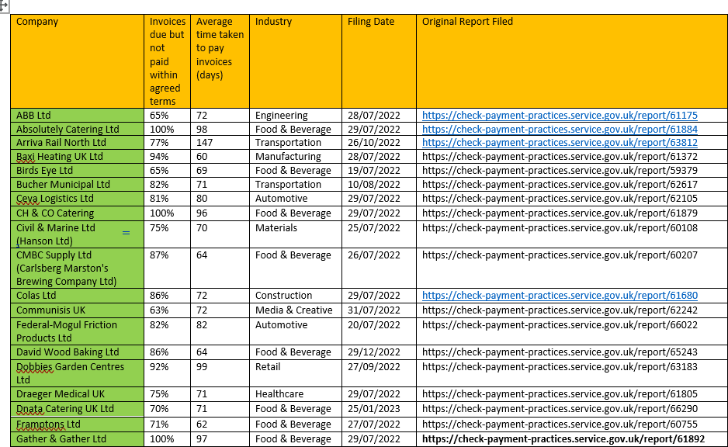
We call out slow and late payers…

Slide 18
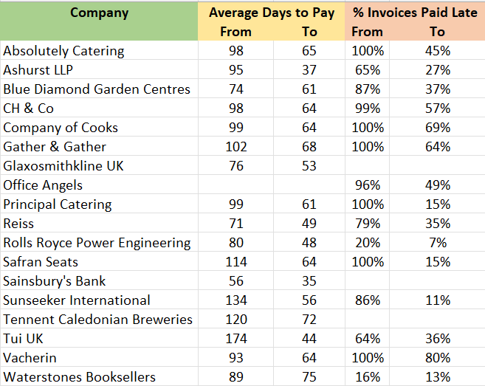
We have directly influenced a reduction in slow and late payment in many big businesses
…. helping thousands of their small and medium sized suppliers

Slide 19
Progress: Rolls-Royce plc 80 days to 50 days!
Average Daysto Pay
ROLLS-ROYCEPOWER ENGINEERINGPLC
85
80
80
76
75
70
65
60
60
55
50
50
45
Dec-20
Mar-21
Jun-21
Sep-21 Dec-21 Mar-22 Jun-22
Source: BEISPrompt Payment Reports BEIS:prompt payment data - GOV.UK(www.gov.uk)

Slide 20
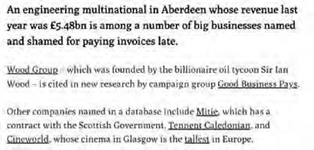
Progress: Tennents 120 days to 72 days!
TENNENTCALEDONIAN BREWERIESUK LIMITED
Average
Daysto Pay
120
120
110
100
90
80
82
75 72
Sep-21 Dec-21 Mar-22 Jun-22
Source: BEISPrompt Payment Reports BEIS:prompt payment data - GOV.UK(www.gov.uk)
70
Dec-20
Mar-21
Jun-21

Slide 21
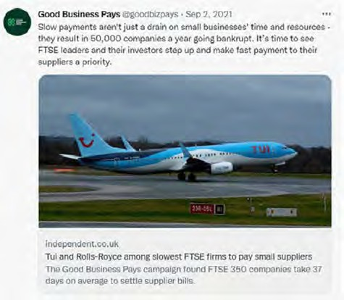
Progress: Tui UK Ltd 174 days to 49 days!
Average Daysto Pay
TUI UKLIMITED
180
174
160
140
120
101
100
80
57
60
49
40
Dec-20
Mar-21
Jun-21
Sep-21 Dec-21 Mar-22 Jun-22
Source: BEISPrompt Payment Reports BEIS:prompt payment data - GOV.UK(www.gov.uk)

Slide 22
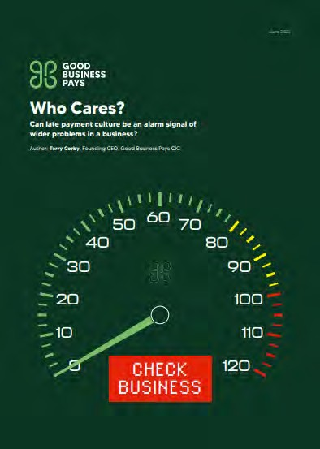
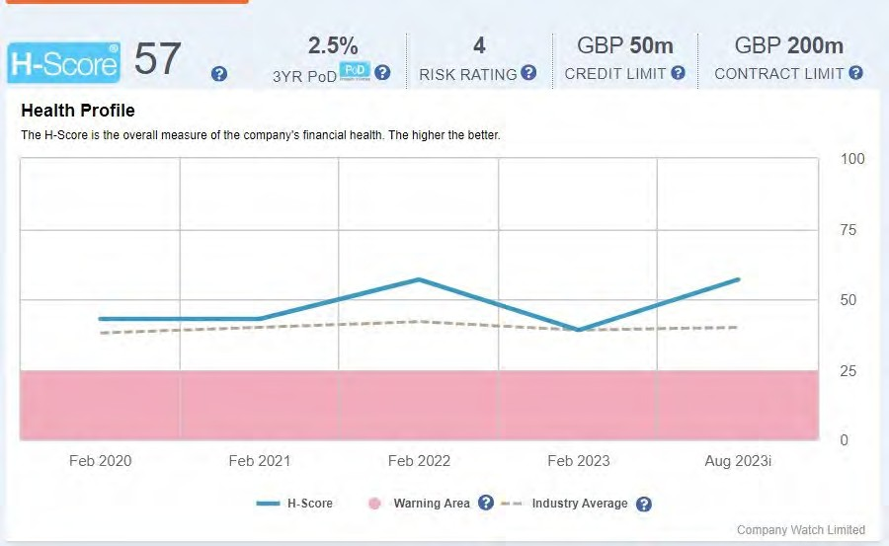
And the Ugly …. When things go very badly

Slide 23
Joules Ltd - Average Invoice Payment Times (Days)
70
Administration Jan 2022
65
60
55
50
45
40
35
Joules
30
25
01/12/2017
01/06/2018
01/12/2018
01/06/2019
01/12/2019
01/06/2020
01/12/2020
01/06/2021
01/12/2021
01/06/202

Slide 24
Miss Selfridge Retail - Average Invoice Payment Times (Days)
80
70
Miss Selfridge
Arcadia Administration Nov 2020
60
50
40
30
20
10
01/03/2018
01/09/2018
01/03/2019
01/09/2019
01/03/2020
01/09/2020
MISS SELFRIDGE RETAIL LIMITED BOOHOO. COM LIMITED
JD SPORTS
PRIMARK STORES LIMITED NEXT RETAIL LIMITED
THE BODY SHOP INTERNATIONAL LIMITED
H&M

Slide 25
Debenhams Retail - Average Invoice Payment Times (Days)
65
60
55
Debenhams Retail
Administration Dec 2020
50
45
40
35
30
25
20
15
01/03/2018
01/09/2018
01/03/2019
01/09/2019
01/03/2020
01/09/2020
DEBENHAMS RETAIL LIMITED
PRIMARK STORES LIMITED
BOOHOO. COM LIMITED
NEXT RETAIL LIMITED
M&S

Slide 26
Midas Construction Ltd 2018 – 2021 Average Invoice Payment Times (Days)
Midas Construction
60
Midas entered Administration Feb 2022
50
40
30
20
10
01/07/2018
01/01/2019 01/07/2019 01/01/2020
AMEY GROUP SERVICES LIMITED BALFOUR BEATTY GROUP LIMITED MACE LIMITED
01/07/2020
01/01/2021 01/07/2021 01/01/2022 01/07/2022
MORGAN SINDALL CONSTRUCTION & INFRASTRUCTURE LTD TARMAC TRADING LIMITED
MIDAS CONSTRUCTION LIMITED
01/01/202

Slide 27
Flybe Aviation - Average Invoice Payment Times (Days)
55
50
Flybe Aviation
Flybe stopped reporting 2019 – entered Administration
Jan 2023
45
40
35
30
25
20
15
01/10/2018
01/04/2019
01/10/2019
FLYBE AVIATION SERVICES LIMITED
JET2.COM LIMITED
LOGANAIR LIMITED
BRITISH AIRWAYS PLC
TUI AIRWAYS LIMITED

Slide 28
What can you do about it?

Slide 29
Clear Payment Terms:
Ensure that payment terms are clearly defined in contracts or agreements with all clients.
Clearly stipulate the payment due dates, late payment penalties, and any interest charges for overdue payments.

Slide 30
Prompt & Accurate Invoicing:
Issuing invoices promptly after providing goods or services is crucial
Make sure you understand the format they need the invoice in and stick to it
Timely invoicing plays a key role in establishing the anticipated payment schedule and kick-starting the payment process in a timely manner
Ensure the invoice prominently displays the due date and the bank account to which payments should be made

Slide 31
Regular Follow-Ups:
Implement a system for regular follow-ups on outstanding invoices
Establish a schedule for payment reminders via email, phone calls, or automated reminders to prompt clients about upcoming or overdue payments
Don’t procrastinate; escalate internally and, if that doesn’t work, utilise the services of a third party
Keep your invoices at the top of the list for payment
Always do what you said you were going to do when you said you were going to do it.

Slide 32
Flexible Payment Options:
Provide multiple payment methods to make it convenient for each of your clients to pay
Offering online payment options or various modes of payment can expedite the payment process

Slide 33
Engage in Relationship Building:
Developing strong relationships with clients can significantly impact payment timelines
Although it shouldn’t be a requirement for timely payments, fostering positive relationships often results in quicker transactions
Clear communication and a positive relationship can lead to better adherence to agreed-upon payment terms
Learn, and follow closely, the client’s requirements for processing invoices, and make friends with people in the Accounts Payables team who will be processing payments
Understand when their payment runs are

Slide 34
Implement Late Payment Penalties:
Enforcing late payment penalties for overdue invoices, as previously agreed upon in the initial contract, can act as a deterrent for clients who might otherwise delay payments
This measure not only encourages adherence to the agreed-upon payment schedule but also serves as a mechanism to deter delays in settling invoices
Even if not included within the contract, late payment interest and penalties can be charged under the Late Payment of Commercial Debts Act

Slide 35
Utilise Technology:
Take advantage of accounting and invoicing software to automate the invoicing and payment tracking procedures
These tools offer a streamlined approach to invoicing and aid in tracking payments efficiently
Additionally, they can generate alerts for overdue payments, facilitating better management of outstanding invoices.

Slide 36
If you tackle slow paying customers you’ll gain time and ££££
According to the Department of Business & Trade, in 2022, Small and Medium-sized Enterprises (SMEs) were owed on average an estimated
£22,000 in late payments
Further research by Tide (2020) suggests that the average time of small business chasing unpaid invoices is at 1.5 hours per SME per day. This equates to approximately 47 days per year.
What would you do with 47 employee days or £22,000?

