Slide 1


TO REPLACE IMAGE:
Click on the picture, hit Delete
Click the ‘Add Picture’ icon
Find your image & click ‘Insert’
Right click on the image
From the drop down menu select
‘Send to Back’ to reveal the
text & logo
** Please note that the date on the bottom left, automatically updates
Air Conference 11May2022
IATA Update
Elena Ciuperceanu
IATA UK & Ireland

Slide 2
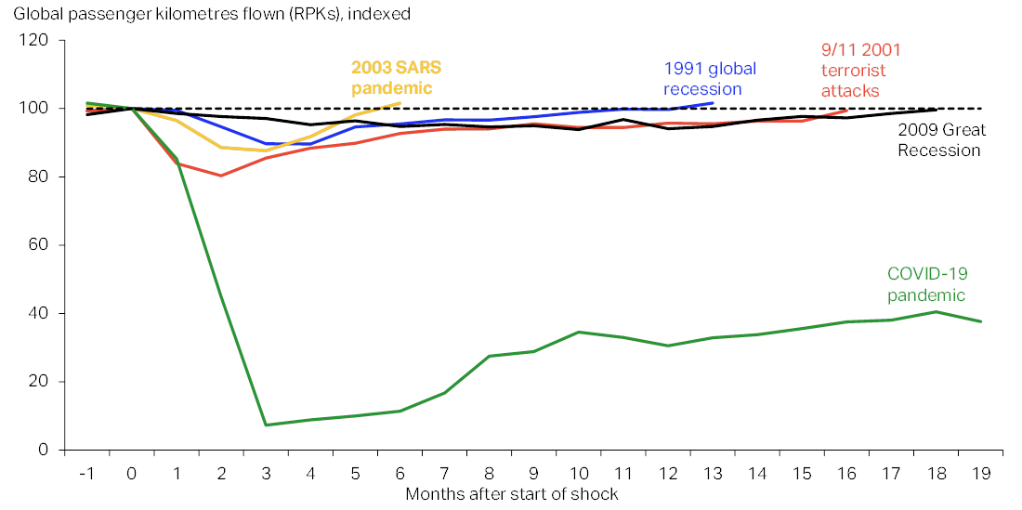
A global shock that no one expected

Slide 3
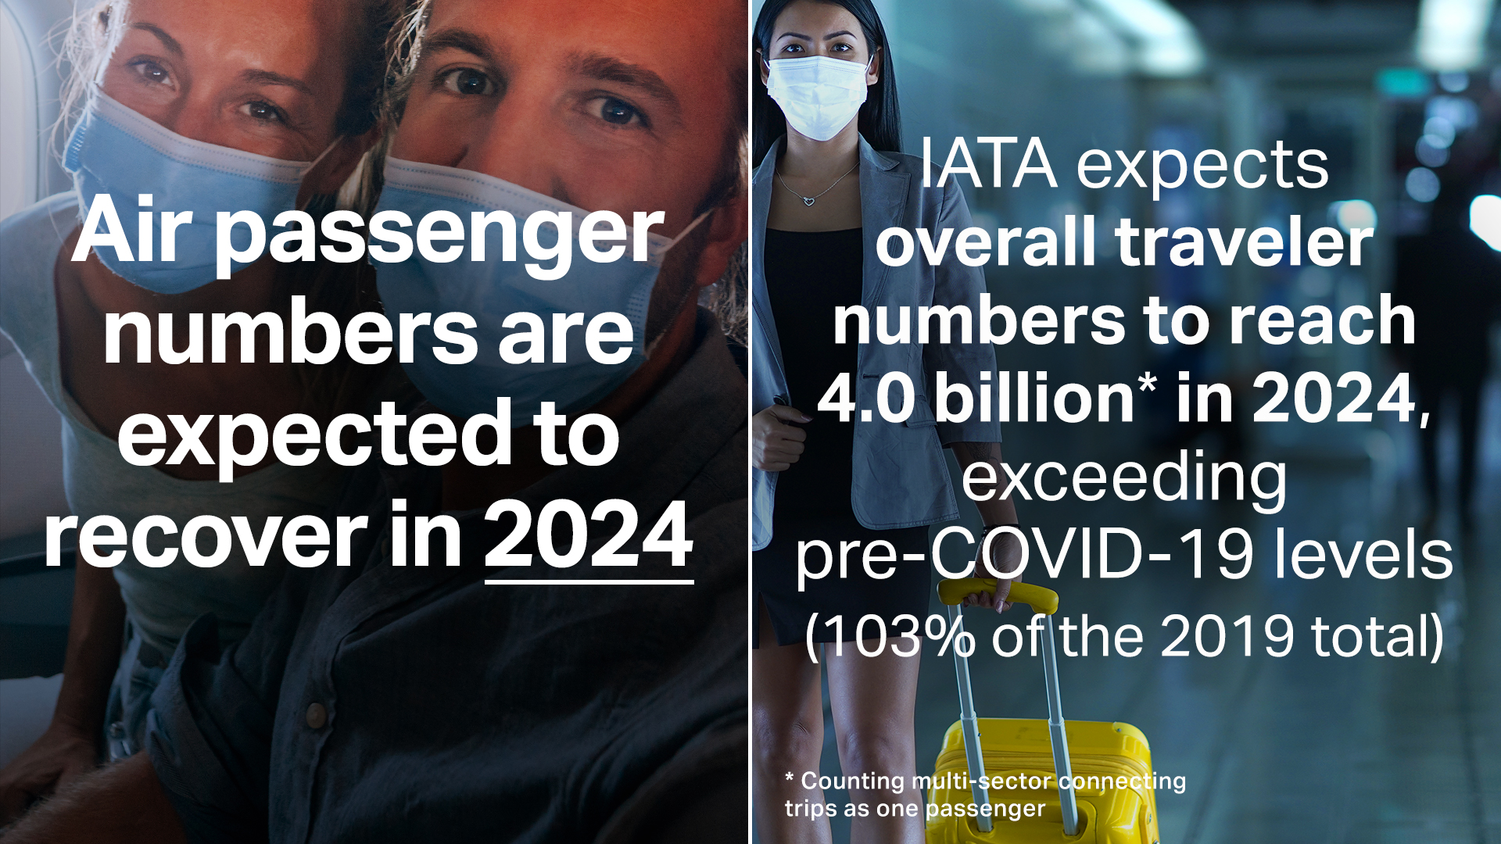

Slide 4
Global IATA forecast
Positive pandemic evolution, but setbacks still a risk + weak Asia

Slide 5

But the sector still faces a turbulent time
Three opportunities:
Easing of restrictions
Pent up demand
Cargo has flourished
Three threats:
Debt burden
Fuel price
Sustainability

Slide 6

Debt Burden

Slide 7
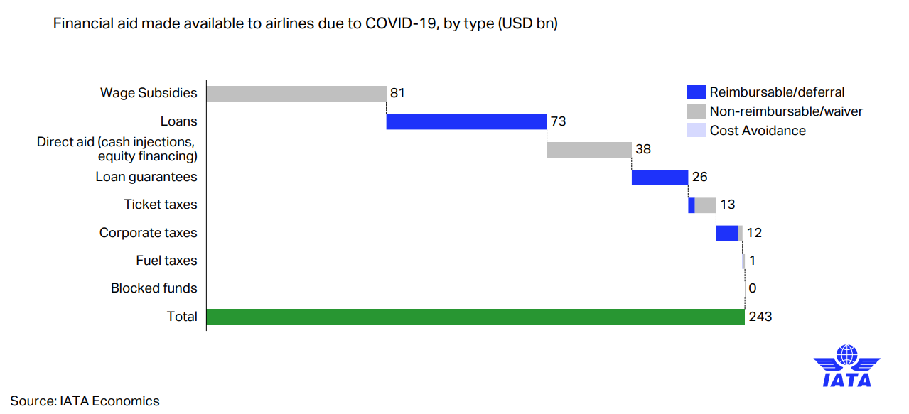
Airlines are capital intensive - loans and debts that kept the sector alive now need to be repaid
TEXT FORMATTING / LIST LEVELS
To change the text formatting or list level:
Highlight the paragraph or sentence
From the Home tab, select the ’Increase List Level’ button
Click the button once to remove the blue subtitle
Click again to add the first level bullet point etc
To go back a level, use the ‘Decrease List Level’ button
Notes:
$110bn + reimbursable debt

Slide 8
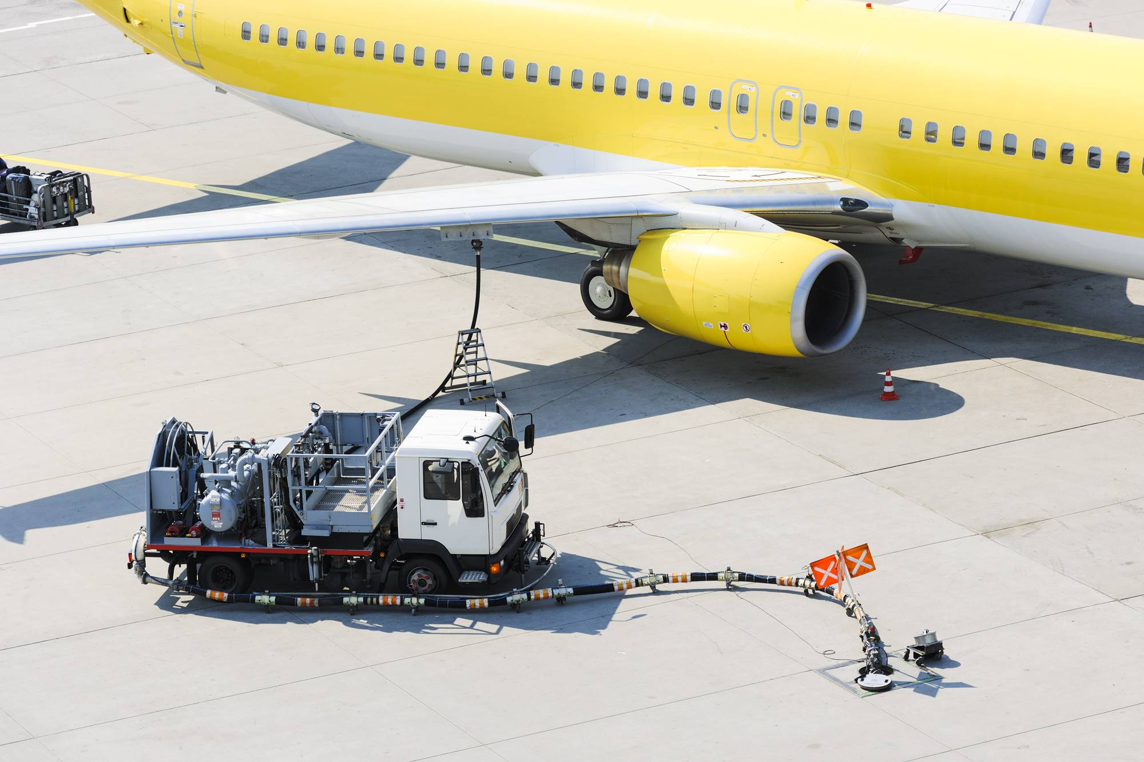
Fuel price

Slide 9
Jet fuel price soaring amid supply concerns
Jet fuel price up 45% year-to-date, putting pressure on airlines’ costs

Slide 10

Sustainability

Slide 11
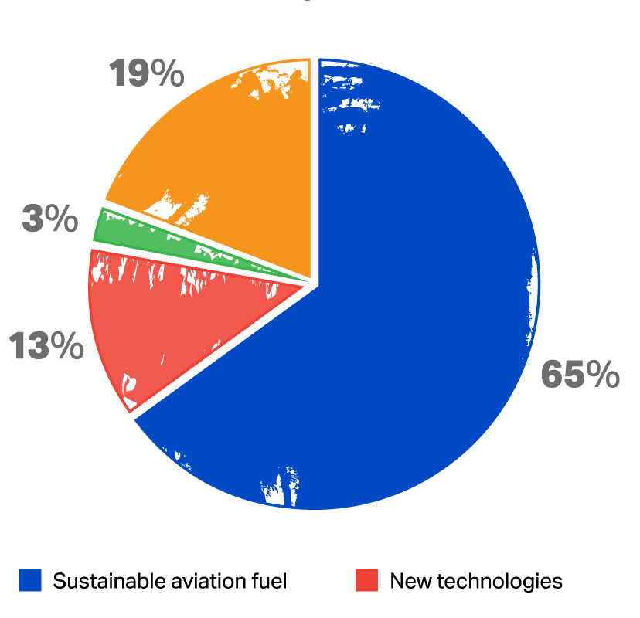

Achieving net zero globally by 2050 needs collective effort
Combination of measures
Sustainable Aviation Fuel, new, technologies, operational and infrastructure improvements, and offsetting/carbon capture.
Collective effort
of the entire industry together with governments, oil producers and investors.

Slide 12

COVID restrictions easing

Slide 13
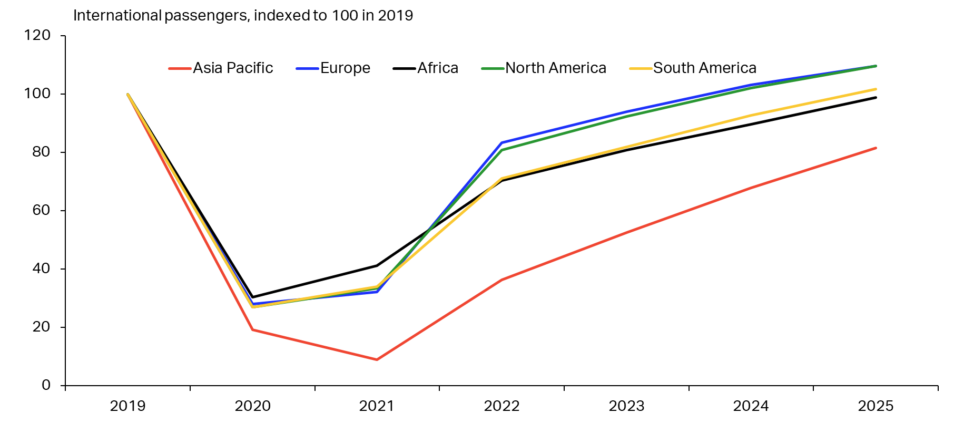
International recovery particularly slow in Asia
China may not reopen before H2 22. Rest of region reopens gradually
Notes:
The delay to the international recovery is partly driven by Asia.
This is the main region where we expect ongoing relatively strict travel restrictions and overall cautious behaviour. For China in particular, we do not expect a clear reopening before H2 2022. Other Asian countries expected to reopen only gradually, with some setbacks
Other regions will be faster to remove most of the problematic restrictions
Africa and South America also struggles in the medium term (2023 onward) partly due to economic scars and slow vaccine distribution

Slide 14
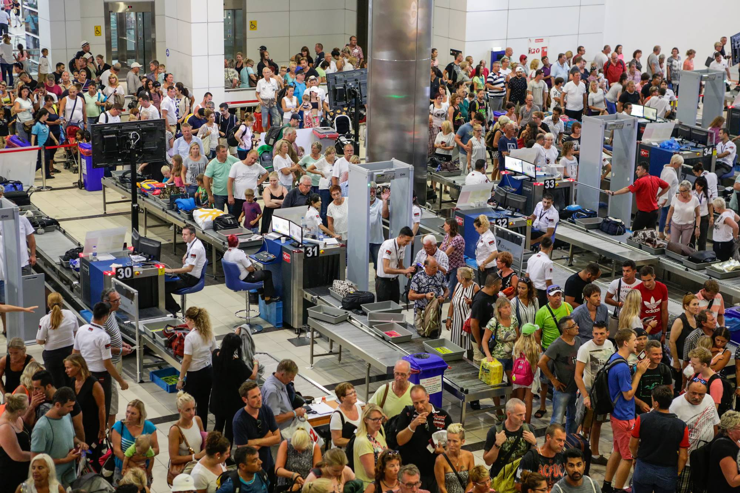
Pent up demand

Slide 15
Travel demand is still fragile in some markets
Recovery led by price-sensitive leisure travelers

Slide 16
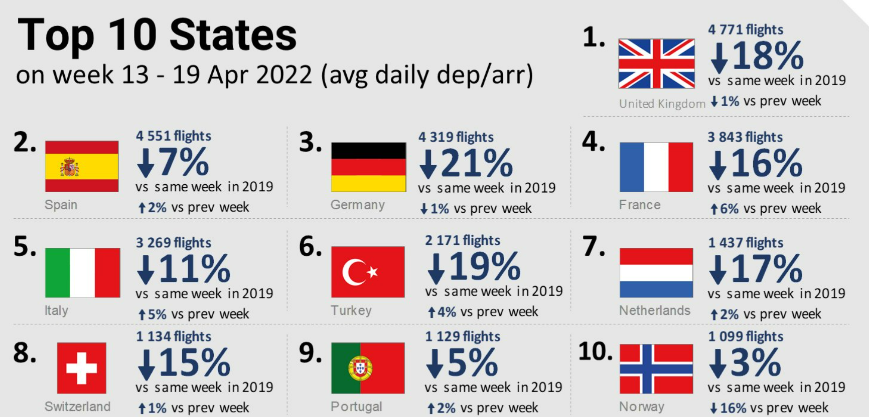
Source: Eurocontrol

Slide 17
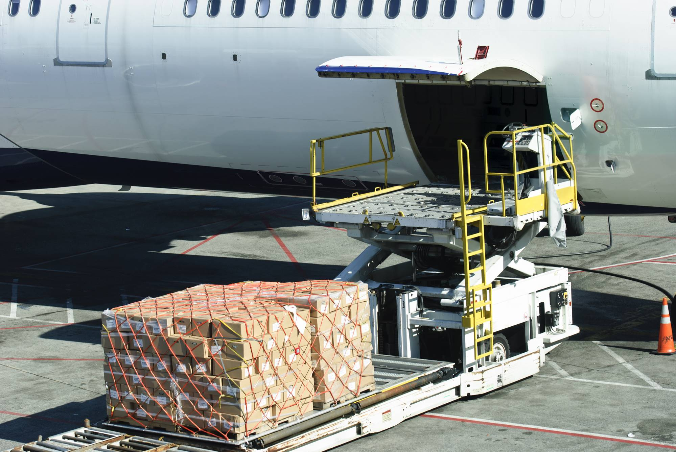
Cargo has flourished

Slide 18
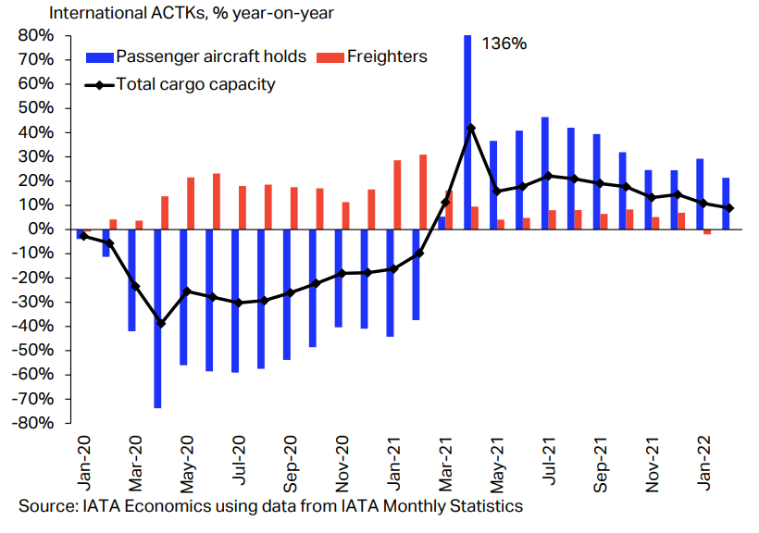
Air cargo has remained resilient throughout the pandemic
2.9% YoY cargo growth (Feb 2022)
Belly hold capacity returned strongly
This helped to sustain passenger airline financial health

Slide 19
But the World facing a new challenge:
Attention turns to Eastern Europe as COVID concerns fade
Notes:
New challenge

Slide 20
10 most affected countries are in Eastern Europe: Ukraine and Moldova show the largest fall in bookings
Difference in net airline bookings (sales minus refunds) made during the week of 24 Feb vs. the week prior, for travel at any future date to/from the wider Europe region, %
-34%
-31%
-31%
-31%
-27%
-27%
-42%
-52%
-112%
-145%
Ukraine
Moldova
Russian Federation
Latvia
Bulgaria
Slovenia
Lithuania
Estonia
Croatia
Czech Republic
* Difference in net bookings < -100% can occur if there were more refunds than new bookings processed the week of 24 Feb so net bookings for that week were negative.

Slide 21
But Ticket sales US to Europe highlight resilient confidence

Slide 22
BSPUK:
Road to recovery

Slide 23
BSPUK Operations – 2019 to date – Sales settled

Slide 24
BSPUK Operations - 2019 to date- docs. settled

Slide 25
BSPUK- Topical issues
Remittance Holding Capacity (RHC)
        Monitoring and calculation-current process
UK Local Financial Criteria for Annual reviews
        Review process and change – update

